Slide 1
Window-based Stream Data Analytics with SPARK and Kafka
4. Introduction to Apache Kafka and its setup

Slide 2
Learning Outlines
What is messaging system?
Point to point
Publish-subscribe (pub-sub)
Apache Kafka
Terminology
Architecture
Why Kafka?
Kafka Setup

Slide 3
Learning Outlines
What is messaging system?
Point to point
Publish-subscribe (pub-sub)
Apache Kafka
Terminology
Architecture
Why Kafka?
Kafka Setup

Slide 4
What is a Messaging System?
A Messaging System is responsible for transferring data from one application to another
Applications do not involve in how to share data.
Distributed messaging:
Point to point
Publish-subscribe (pub-sub)

Slide 5

Point to Point Messaging System
This system uses a queue to persist messages
One or more consumers can consume the messages in the queue
but a particular message can be consumed by just one consumer.
Then, it will disappear from the queue.
Sender
Message
Queue
Receiver

Slide 6
Publish-Subscribe Messaging System
In this system, messages are persisted in a topic.
Consumers can subscribe to one or more topic and consume all the messages in that topic.
Message producers are called publishers and message consumers are called subscribers.
Producer
Subscribe
Consumer
Publish (topic, msg)
Topic 1
msg
Topic 3
Producer
Consumer
Topic 2
Subscribe

Slide 7
Learning Outlines
What is messaging system?
Point to point
Publish-subscribe (pub-sub)
Apache Kafka
Terminology
kafka Architecture
Why Kafka?
Kafka Setup

Slide 8
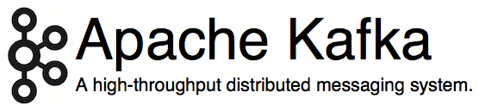
Apache Kafka
Originated at LinkedIn, open sourced in early 2011
Implemented in Scala, some Java
9 core committers, plus ~ 20 contributors
http://kafka.apache.org/

Slide 9
Kafka?
LinkedIn’s motivation for Kafka was:
“A unified platform for handling all the real-time data feeds a large company might have.”
Features
High throughput to support high volume event feeds.
Support real-time processing of these feeds to create new, derived feeds.
Support large data backlogs to handle periodic ingestion from offline systems.
Guarantee fault-tolerance in the presence of machine failures.

Slide 10
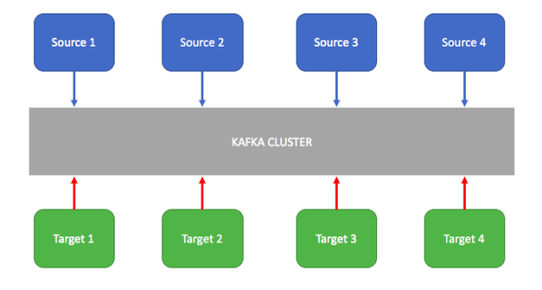
Apache Kafka
Kafka is used as an enterprise messaging system to decouple source and target systems to exchange data.
Kafka provides high throughput with partitions and fault tolerance with replication.
Notes:
Source: https://dzone.com/articles/introduction-to-apache-kafka-1

Slide 11
Apache Kafka
Apache Kafka is a distributed publish-subscribe messaging system and a robust queue that can handle a high amount of data.
Kafka maintains feeds of messages in topics. Producers write data to topics and consumers read from topics. Since Kafka is a distributed system, topics are partitioned and replicated across multiple nodes.
Kafka
Cluster
Consumer
Producer
Consumer
Producer
Consumer

Slide 12
Apache Kafka
Topics
Kafka Brokers
Leader
Partition 1
Server 1
0 1
Replica
1
Consumer
Producer
p1
Partition 2
Follower
Read/ pull data
0 1 2
Server 2
Consumer
Write/ Push data
Replica
2
P2
Producer
Partition 3
Follower
Consumer
0
Server 3
p3
Replica
3
Old - - - - - - - > New

Slide 13
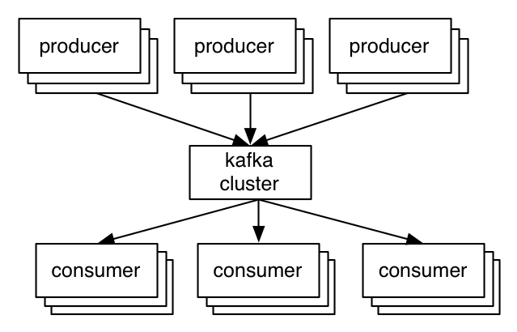
A first look
The who is who
Producers write data to brokers.
Consumers read data from brokers.
All this is distributed.
The data
Data is stored in topics.
Topics are split into partitions, which are replicated.

Slide 14
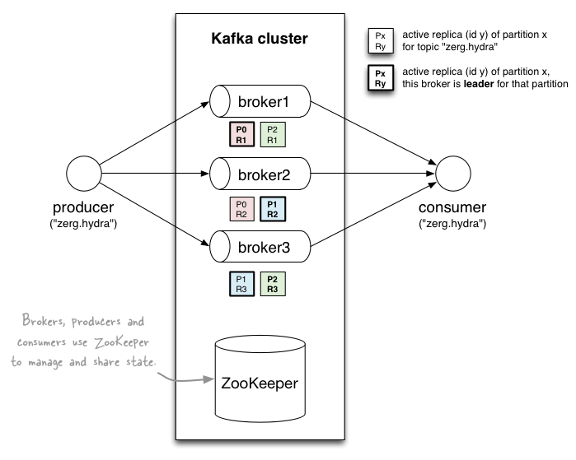
A first look

Slide 15
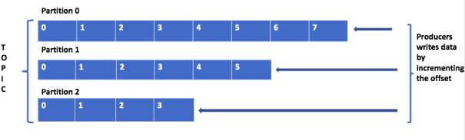
Apache Kafka: Terminology
Topic: A stream of messages belonging to a particular category.
Partition: Topics are split into partitions.
For each topic, Kafka keeps one or more partitions.
Each partition has a unique sequence ID called offset.
Example: In the previous diagram, a topic has three partitions. Partition 1 has two offset factors 0 and 1.
Notes:
A topic is a logical name to which the records are published. Internally, the topic is divided into partitions to which the data is published. These partitions are distributed across the brokers in the cluster. For example, if a topic has three partitions with three brokers in the cluster, each broker has one partition. The published data to partition is append-only with the offset increment.
Source: https://dzone.com/articles/introduction-to-apache-kafka-1

Slide 16
Apache Kafka: Terminology
Below are some points we need to remember when working with partitions.
Topics are identified by name. We can have many named topics in a cluster.
The order of messages is maintained at the partition level, not across topics.
Once the data written to the partition, it is not overridden. This is called immutability.
The messages in partitions are stored with keys, values, and timestamps. Kafka ensures publishing the message to the same partition for a given key.
From the Kafka cluster, each partition will have a leader that will take read/write operations to that partition.

Slide 17
Topics
Consumer group C1
Consumers use an “offset pointer” to
track/control their read progress
(and decide the pace of consumption)
Consumer group C2
Producer A1
Producer A2
…
…
new
Producer An
Older msgs
Newer msgs
Producers always append to “tail”
(think: append to a file)
Broker(s)

Slide 18
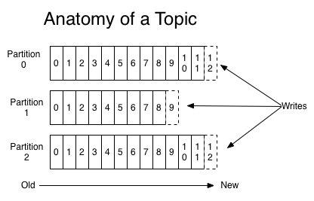
Partitions
A topic consists of partitions.
Partition: ordered + immutable sequence of messages that is continually appended to

Slide 19
Partition offsets
Offset: messages in the partitions are each assigned a unique (per partition) and sequential id called the offset
Consumers track their pointers via (offset, partition, topic) tuples
Consumer group C1

Slide 20
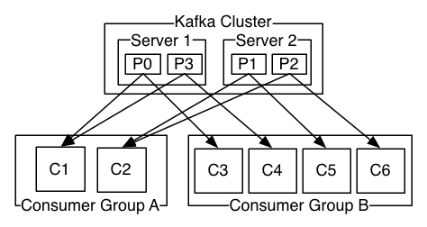
Partitions
#Partitions of a topic is configurable
#Partitions determines max consumer (group) parallelism
Consumer group A, with 2 consumers, reads from a 4-partition topic
Consumer group B, with 4 consumers, reads from the same topic

Slide 21
Replicas of a partition
Replicas: “backups” of a partition
They exist solely to prevent data loss.
Replicas are never read from, never written to.
They do NOT help to increase producer or consumer parallelism!
Kafka tolerates (numReplicas - 1) dead brokers before losing data
LinkedIn: numReplicas == 2 → 1 broker can die

Slide 22
Apache Kafka: Terminology
Replicas: They are the backups of a partition.
Broker: Kafka run as a cluster comprised of one or more servers each of which is called broker.

Slide 23
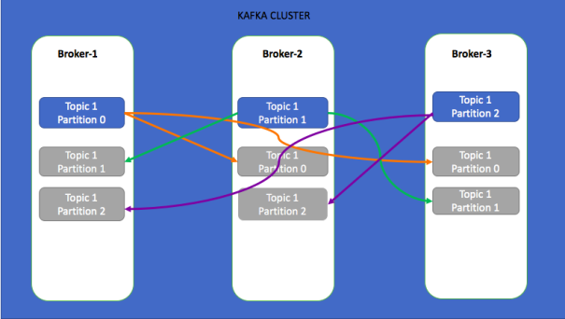
Apache Kafka: example
Notes:
In this example, a topic with three partitions with a replication factor of 3 has been created. In this case, as the cluster has three brokers, the partitions are evenly distributed and the replicas of each partition are replicated over to another two brokers. As the replication factor is 3, there is no data loss — even if two brokers goes down. Always keep the replication factor greater than 1 and less than or equal to the number of brokers in the cluster. You can not create a topic with a replication factor more than the number of brokers in a cluster.
In the above diagram, for each partition, there is a leader (glowing partition) and other in-sync replicas (gray out partitions) are followers. For partition 0, the broker-1 is leader and broker-2 and broker-3 are followers. All the reads/writes to partition 0 will go to broker-1 and the same will be copied to broker-2 and broker-3.
Source: https://dzone.com/articles/introduction-to-apache-kafka-1

Slide 24
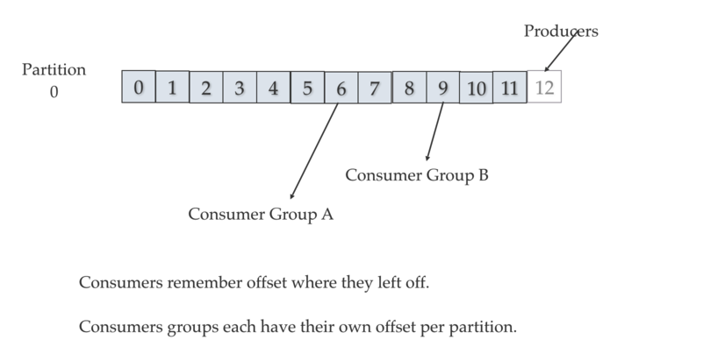
Kafka Consumer Group
Notes:
Consumers remember offset where they left off reading. Consumers groups each have their own offset per partition.
Source: http://cloudurable.com/blog/kafka-architecture-consumers/index.html

Slide 25
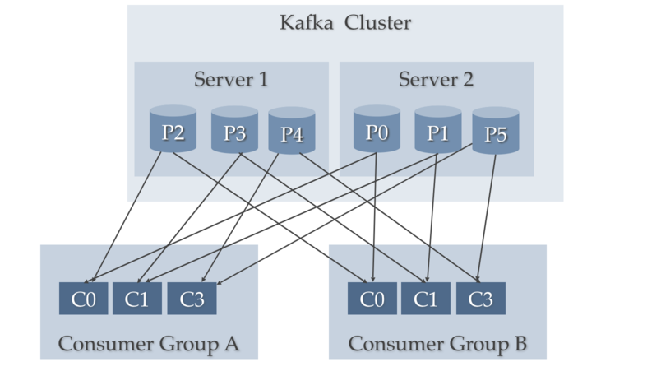
2 server Kafka cluster hosting 4 partition (P0-P5)
Notes:
Notice server 1 has topic partition P2, P3, and P4 while server 2 has partition P0, P1, and P5. Notice that Consumer C0 from Consumer Group A is processing records from P0 and P2. Notice that no single partition is shared by any consumer from any consumer group. Notice that each partition gets its fair share of partitions for the topics.
Source: http://cloudurable.com/blog/kafka-architecture-consumers/index.html

Slide 26
Zookeeper
Zookeeper is an open source and high performance coordination service for distributed applications.
ZooKeeper is used for managing and coordinating Kafka brokers.
ZooKeeper is mainly used to notify producers and consumers about the presence of any new broker in the Kafka system or about the failure of any broker in the Kafka system.
ZooKeeper notifies the producer and consumer about the presence or failure of a broker based on which producer and consumer makes a decision and starts coordinating their tasks with some other broker.
http://zookeeper.apache.org/

Slide 27
Kafka Architecture
Kafka Cluster
Consumer
Broker 1
Producer
Broker 2
Consumer
Write/ Push data
Read/ pull data
Producer
Broker 3
Consumer
get kafka broker id
Update Offset
Zookeeper

Slide 28
Why is Kafka so fast?
Fast writes:
While Kafka persists all data to disk, essentially all writes go to the page cache of OS, i.e. RAM.
Fast reads:
Very efficient to transfer data from page cache to a network socket
Linux: sendfile() system call
Combination of the two = fast Kafka!

Slide 29
Kafka + X for processing the data?
Kafka + Storm often used in combination, e.g. Twitter
Kafka + custom
“Normal” Java multi-threaded setups
Akka actors with Scala or Java, e.g. Ooyala
New additions:
Samza (since Aug ’13) – by LinkedIn
Spark Streaming, part of Spark (since Feb ’13)
Kafka + Camus for Kafka->Hadoop ingestion
https://cwiki.apache.org/confluence/display/KAFKA/Powered+By

Slide 30
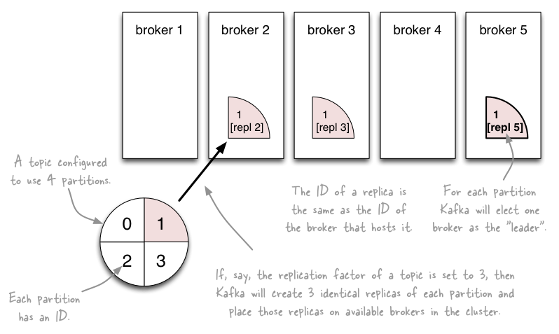
Topics vs. Partitions vs. Replicas

Slide 31
Let’s recap
The who is who
Producers write data to brokers.
Consumers read data from brokers.
All this is distributed.
The data
Data is stored in topics.
Topics are split into partitions which are replicated.

Slide 32
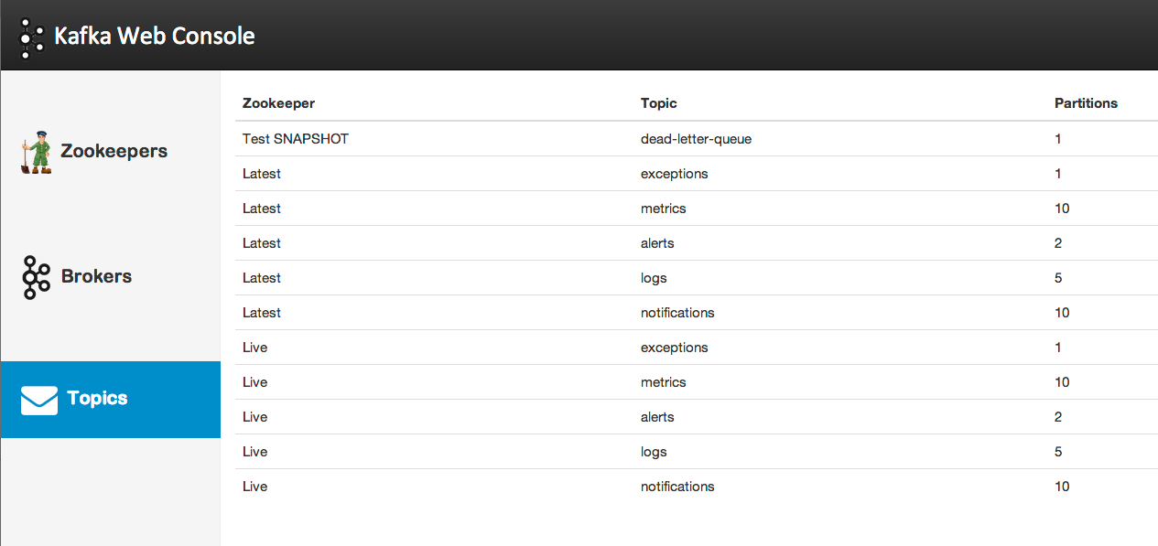
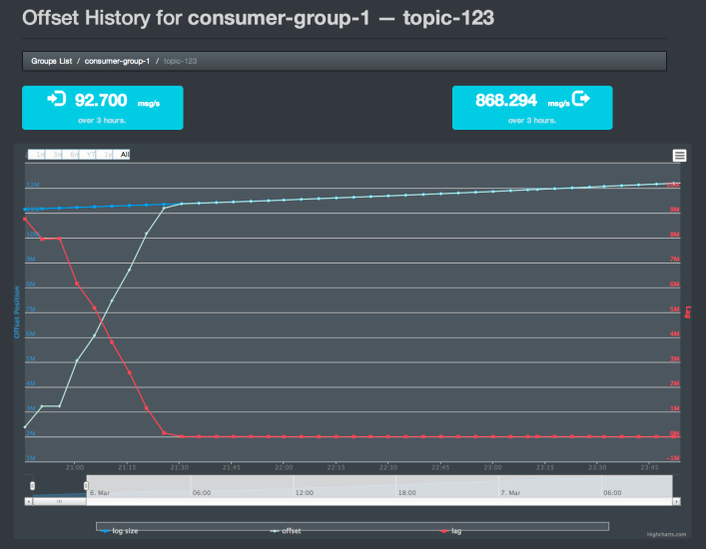
Monitoring Kafka
Nothing fancy built into but see:
https://cwiki.apache.org/confluence/display/KAFKA/System+Tools
https://cwiki.apache.org/confluence/display/KAFKA/Ecosystem
Kafka Web Console
Kafka Offset Monitor

Slide 33
Learning Outlines
What is messaging system?
Point to point
Publish-subscribe (pub-sub)
Apache Kafka
Terminology
Kafka Architecture
Why Kafka?
Kafka Setup

Slide 34
Why Kafka?
Kafka is a fast, scalable, durable, and reliable publish-subscribe messaging system
Scalability - Kafka messaging system scales easily without down time.
Durability - Kafka uses “Distributed commit log” which means messages persists on disk as fast as possible, hence it is durable.
Reliability - Kafka is distributed, partitioned, replicated and fault tolerance.
Performance. Kafka has high throughput for both publishing and subscribing messages. It maintains stable performance even when dealing with many terabytes of stored messages.
Real time streaming data processed for real time analytics
Kafka can works in combination with
Flume/Flafka, Spark Streaming, Storm, HBase and Spark for real-time analysis and processing of streaming data

Slide 35
Learning Outlines
What is messaging system?
Point to point
Publish-subscribe (pub-sub)
Apache Kafka
Terminology
Kafka Architecture
Why Kafka?
Kafka Setup

Slide 36
Kakfa Setup
Operating system: Unix-based (although it also works on Windows platform, these instructions are for unix-based systems)
Step 1: Download the code and un-tar it:
https://www.apache.org/dyn/closer.cgi?path=/kafka/2.1.0/kafka_2.11-2.1.0.tgz
Ref: https://kafka.apache.org/quickstart
Notes:
https://spark.apache.org/docs/2.2.0/streaming-kafka-integration.html

Slide 37
Kakfa Setup (Cont’d)
Step 2: Start the ZooKeeper Server
If you do not have a ZooKeeper server on your system, you can use a single-node Zookeeper instance in the Kafka package.
> bin/zookeeper-server-start.sh config/zookeeper.properties
When it starts successfully, you will see:
[2013-04-22 15:01:37,495] INFO Reading configuration from: config/zookeeper.properties (org.apache.zookeeper.server.quorum.QuorumPeerConfig)
...

Slide 38
Kakfa Setup (Cont’d)
Step 3: Start the Kafka Server
> bin/kafka-server-start.sh config/server.properties
When it starts successfully, you will see:
[2013-04-22 15:01:47,028] INFO Verifying properties (kafka.utils.VerifiableProperties)
[2013-04-22 15:01:47,051] INFO Property socket.send.buffer.bytes is overridden to 1048576 (kafka.utils.VerifiableProperties)
...

Slide 39
Kakfa Setup (Cont’d)
Step 4: Create a topic
To create a topic named “test” with a single partition and one replica:
> bin/kafka-topics.sh --create --zookeeper localhost:2181 --replication-factor 1 --partitions 1 --topic test
If you run the following command, you will see the topic name:
> bin/kafka-topics.sh --list --zookeeper localhost:2181
test

Slide 40
Kakfa Setup (Cont’d)
Step 5: Send some messages by producer:
By using the following command, you can send messages to the server through the producer:
> bin/kafka-console-producer.sh --broker-list localhost:9092 --topic test
This is a test.
This is the second test.

Slide 41
Kakfa Setup (Cont’d)
Step 6: Receive the messages by consumer:
Kafka also has a command line consumer that will dump out messages to standard output:
> bin/kafka-console-consumer.sh --bootstrap-server localhost:9092 --topic test --from-beginning
This is a test.
This is the second test.

Slide 42
Next Lesson
We will also give some example in pyspark about how to extract features from documents:
Tokenizer
Stop word removal
n-gram
TF-IDF
word2vec
We will also give some example in pyspark about how to classify documents with extracted features:
Decision Tree
Naive Bayes
SVM

Slide 43
Reference
Apache Kafka:
https://kafka.apache.org/

